Slide 1
Vehicular Remote Online Ocular brain-Machine-interface - VROOM
CruX Team 2
Project Lead: Mateo Umaguing
Project Scientists: Avantika Aggarwal, Hanna Boughanem, Paige Lee, Sree Nagaraj, Srivarsha Rayasam, Anish Thalamati
Mechanical Engineer: Audrey Ngai

Slide 2



SSVEPs
CLASSIFICATION
DATA

Slide 3

SSVEP Review

Slide 4

SSVEP Review

Slide 5
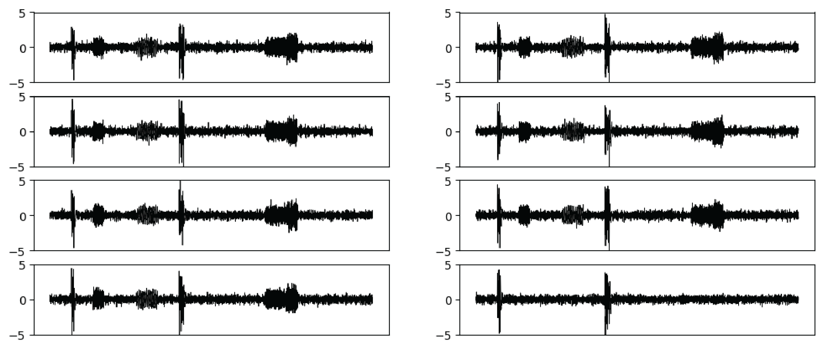
Simulated Data

Slide 6
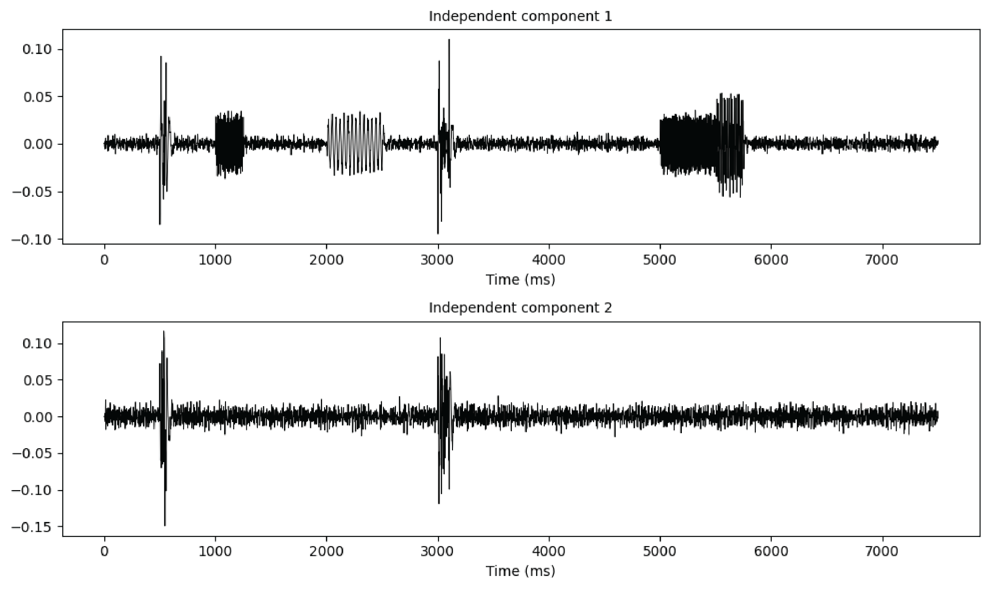
Simulated Data

Slide 7
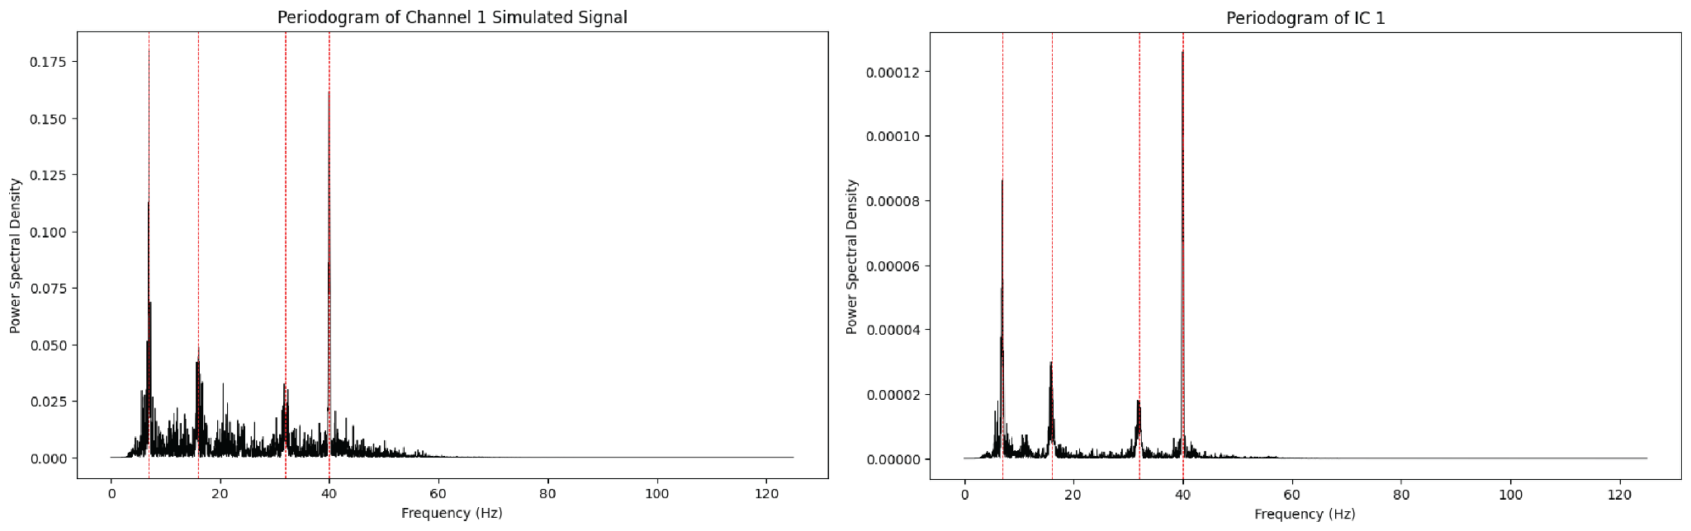
Simulated Data

Slide 8
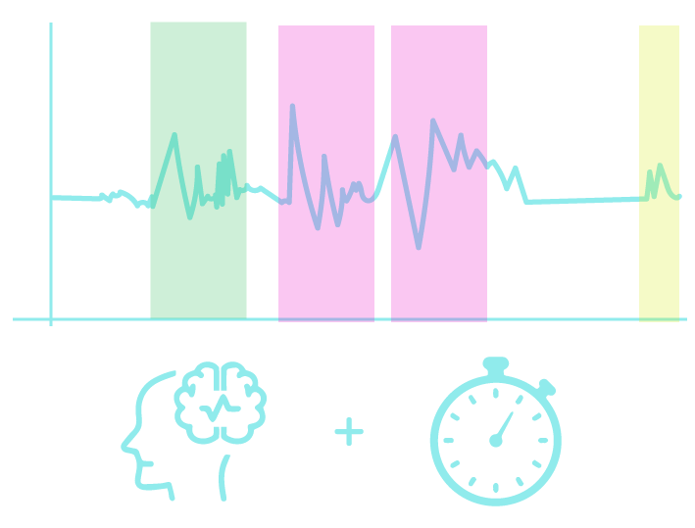
Data Collection

Slide 9
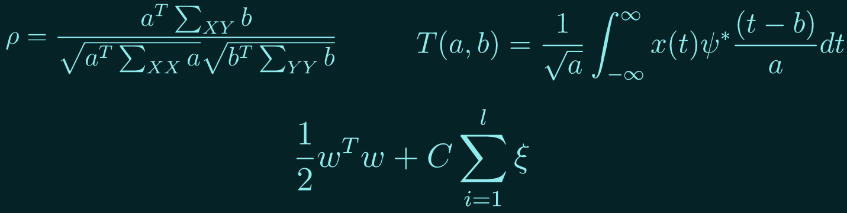
SSVEP Classification Algorithms

Slide 10
“The light at the end of the tunnel might be an oncoming train.”
—Random Internet Person

Slide 11
“The light at the end of the tunnel might be an oncoming train.”
the flashing of a flickering screen to induce steady-state visual-evoked potentials to be used in an awesome BCI that can help disabled people in the future or something

